Slide 1

Dhruv Sakalley
Data Scientist – LexisNexis Legal & Professional
https://github.com/dhruvsakalley/meetups/tree/master/intro_keras
Q&A + Feedback www.menti.com Enter Code: 27 50 85

Slide 2

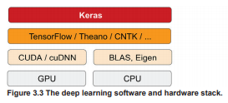
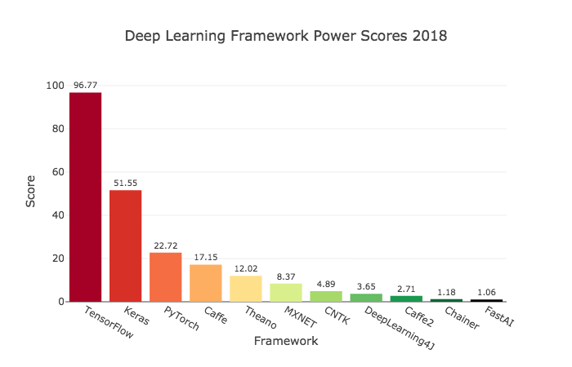
Y?

Slide 3

The Keras functional API for defining complex models, such as multi-output models, directed acyclic graphs, or models with shared layers.
Easy to turn models into products, rapid prototyping, pythonic
Supports multiple backend engines [TensorFlow , CNTK , Theano, MXNet]
Strong multi-GPU support and distributed training support

Slide 4
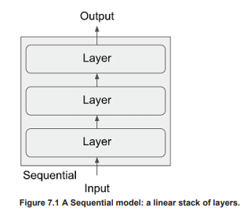
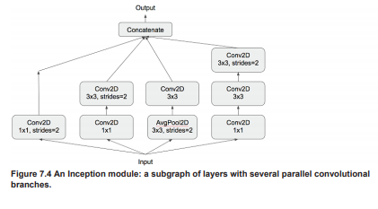
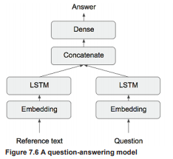
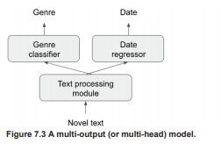
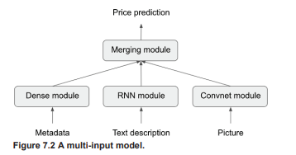
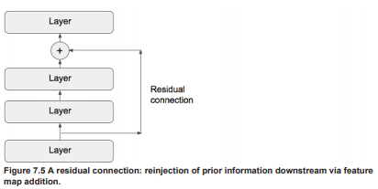
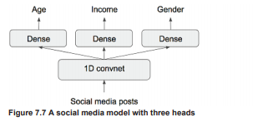
Examples of some model architectures, implemented in Keras

Slide 5


As you reach your prime
High level abstractions hide away details.
Level of control -TensorFlow allows you to create any arbitrary computational graphs, providing much more flexibility.
Debugging/ Iterating on Static Computation Graphs can be slow
Good News! tf.keras + tf = All you ever gonna need

Slide 6

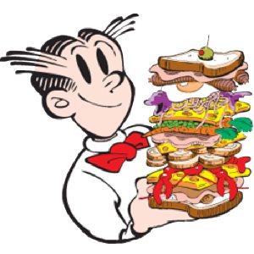
Deep Learning : Neural Networks
:
Notes:
Deep learning, completely automates "feature engineering".
What is transformative about deep learning is that it allows a model to learn all layers of representation jointly, at the same time, rather than in succession ("greedily", as it is called). With joint feature learning, whenever the model adjusts one of its internal features, all other features that depend on it will automatically adapt to the change, without requiring human intervention.
These are the two essential characteristics of how deep learning learns from data: the incremental, layer-by-layer way in which increasingly complex representations are developed, and the fact these intermediate incremental representations are learned jointly, each layer being updated both to follow the representational needs of the layer above and the needs of the layer below. Together, these two properties have made deep learning vastly more successful than previous approaches to machine learning.

Slide 7
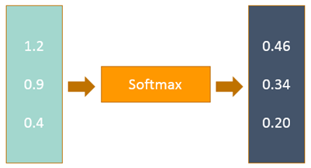
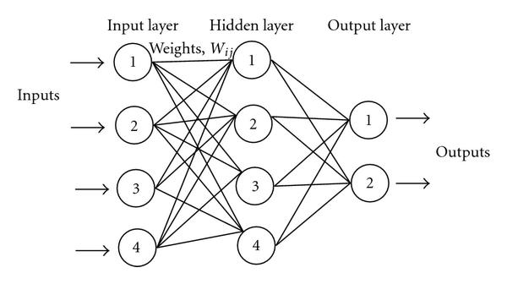
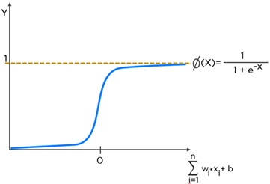
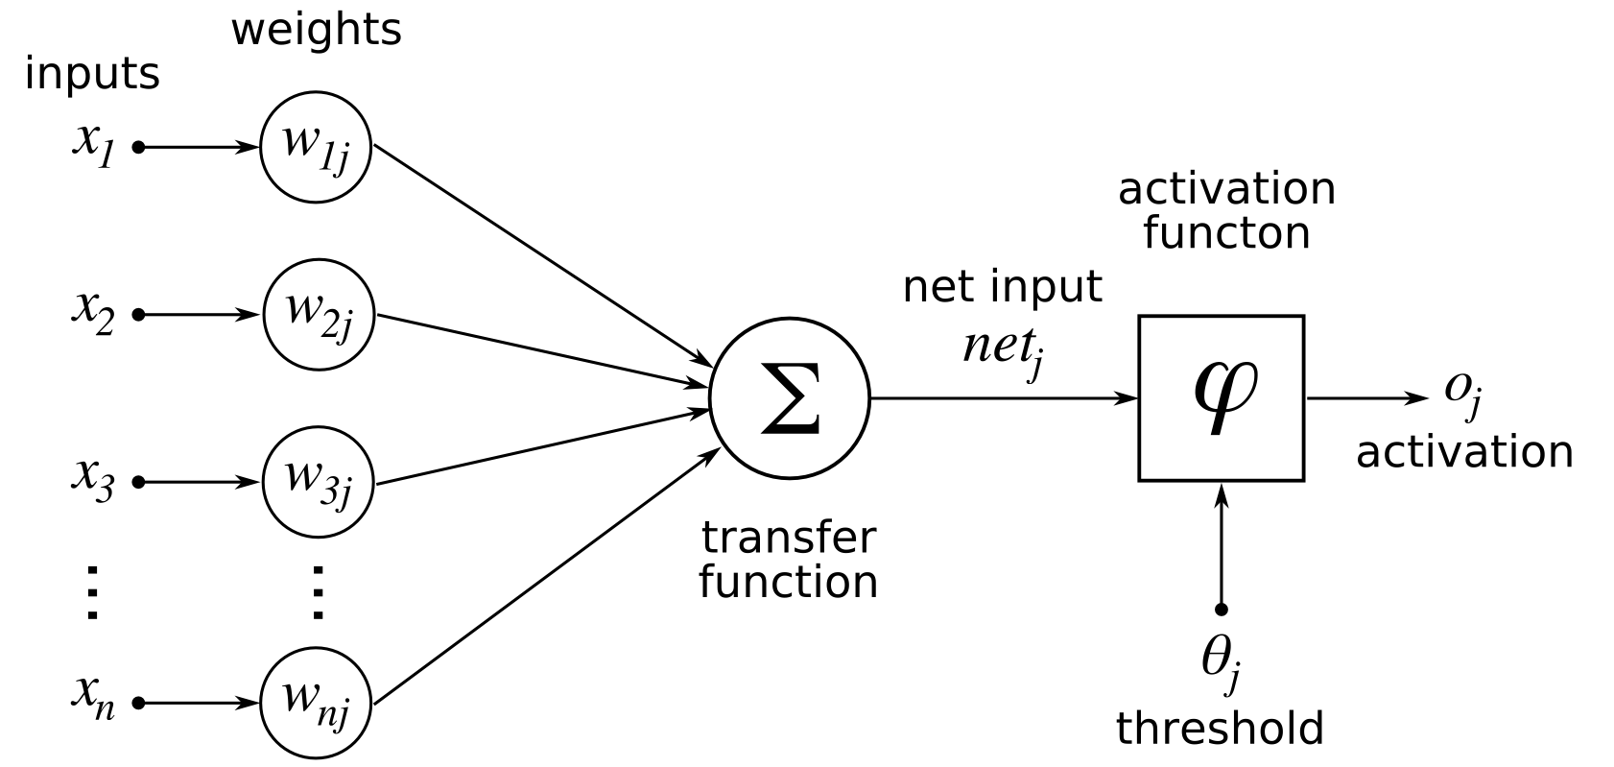
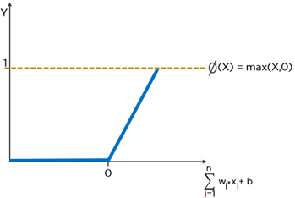
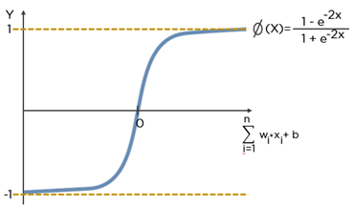
A Simple Neural Network

Slide 8
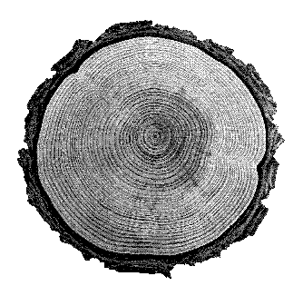
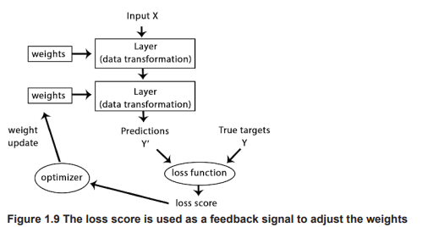
Flow

Slide 9
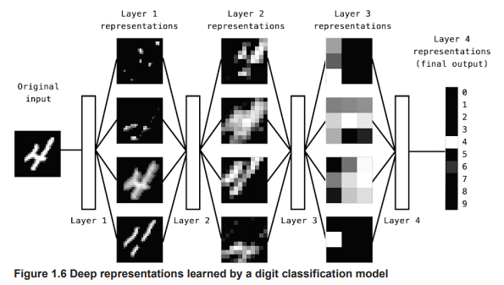
A Deep Neural Network

Slide 10


Not enough!

Slide 11


Tuning Leavers
Type of Models – ex: Sequential
Type of Layers –Subtypes of layers
Loss Functions
Optimizers [Learning Rate; Hyper Params]
Activation Functions
Bias Regularizers
Initializers
Evaluation Metrics
Constraints

Slide 12
Operational Utilities
Preprocessing
Callbacks
Visualization
Datasets
Applications

Slide 13

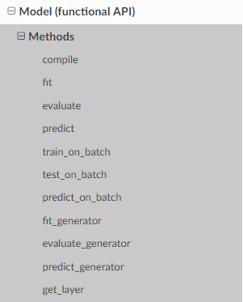
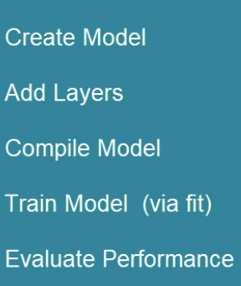

Slide 14

Enough talk Let’s Code!
Install Instruction
Make sure visual studio 2015 C++ tools are installed
A simple walkthrough
Real world examples
> conda create -n keras_env python=3.6 anaconda
> activate keras_env OR $conda activate keras_env
> conda install tensorflow keras pydot graphviz scikit-learn
(add graphviz bin to %PATH% OR $PATH)

Slide 15
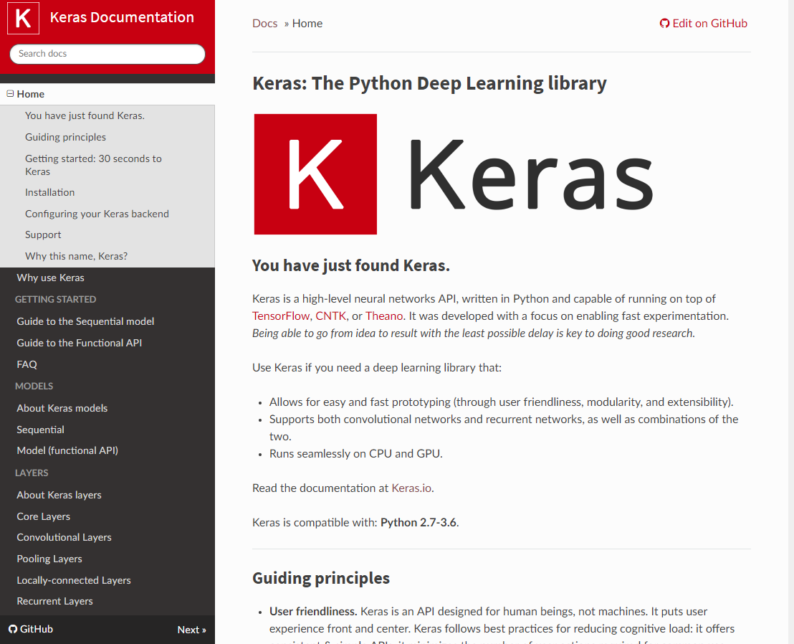

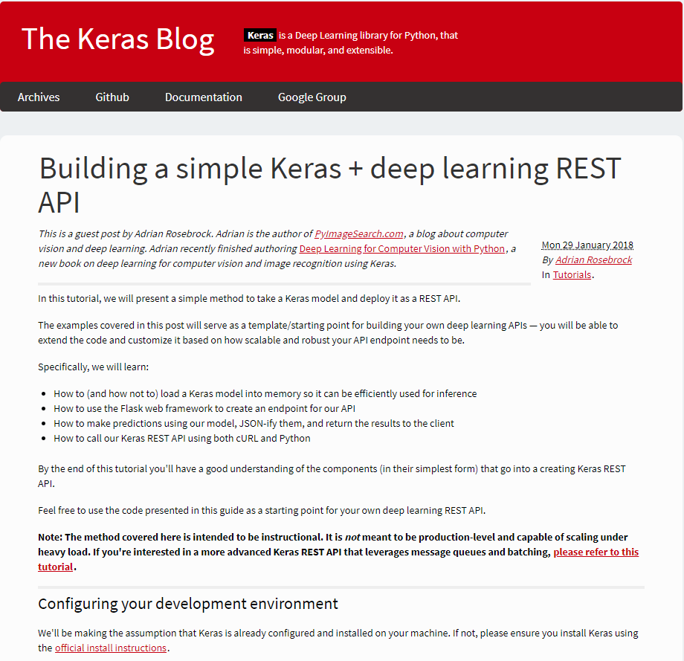
Deep Learning with Python, François Chollet

Slide 16

Resources & Notes
Meetup Contents: https://github.com/dhruvsakalley/meetups/tree/master/intro_keras
Q&A + Feedback www.menti.com Enter Code: 27 50 85
Documentation: Keras.io, sometimes outdated, instead use help()
Updates: blog.keras.io
Slack: kerasteam.slack.com
Examples: github.com/fchollet/keras
https://keras.io/getting-started/faq/#how-can-i-run-keras-on-gpu

Slide 17

Thank you & don’t be a stranger!

